Slide 2
Authentication Protocols
Kerberos
Developed by MIT
Open-source
Time-sensitive authentication
Default for MS Active Directory
Notes:
Do not confuse with 802.11x

Slide 3
Authentication Protocols
Kerberos
Components
Authentication Server
Key distribution center
Ticket-granting ticket
Ticket-granting service
Notes:
Do not confuse with 802.11x

Slide 4

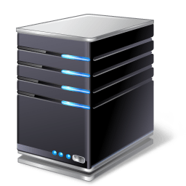


Authentication Protocols
Kerberos Server
Authentication Request
Authentication verified/Encrypted TGT
TGT is sent to TGS with name of resource
TGT Stored
Session key issued
Session Key
Resource Server

